Slide 1

MOBILE DEVELOPMENT
COMPUTER SCIENCE
Topic 8:
Sensor Programming
version 1.0
Copyright © 2020 by Singapore Institute of Management Pte Ltd. All rights reserved.

Slide 2

Learning Outcomes
After studying this topic and the recordings online, you should be able to:
Topic 8 – Sensor Programming
What are sensors?
Categories of Sensors
Guidelines of sensors usage
Accessing the camera
Notable functions of the expo-camera
What are Haptics and Vibrations?
Usage of haptics and vibration in React Native

Slide 3
Learning Outcomes
After studying this topic and the recordings online, you should be able to:
Topic 8 – Sensor Programming
What is GPS?
How does GPS works?
Consideration on the use of GPS
Getting location details in React Native
Notable functions of expo-location
What are Accelerometers?
How are Accelerometers used in smartphones?
Using Accelerometer in React Native

Slide 4

What are sensors?
A sensor is a device that detects or measures a physical property and responds to it.
Examples of sensors:
Accelerometer
Gyroscope
Heart Rate
Camera
And more…
Notes:
B

Slide 5
Categories of sensors on smartphones
Conceptually, there are FIVE (5) categories of sensors:
Device position - gather information about the position of the device. Examples: orientation sensors, magnetometer.
Motion sensors - detect changes in forces around the three axes of the device. Examples: gyroscope, accelerometer.
Environmental sensors - focus on information about the device environment. Examples: ambient temperature sensor, light detection sensor, humidity sensor, barometer, etc.
Notes:
B

Slide 6
Categories of sensors on smartphones
Conceptually, there are FIVE (5) categories of sensors:
Mixed or composite sensors - gather and integrate data from two or more sensors on a device. Examples: step counter, rotational vector sensor.
Internal sensors - detect and report changes related to the device itself. Examples: battery charge.
Notes:
B

Slide 7
Guidelines of sensors usage
Sensors delivers a great advantage to efficient functionality of a mobile app.
There will always be reasons in terms of using sensors.
Notes:
B

Slide 8
Guidelines of sensors usage
These THREE(3) guidelines will aid the rationalism of sensor usage.
Accessibility and Assistive
Function Enhancement
Usage of the sensor data
Notes:
B

Slide 9
Accessing the camera
In native mobile development, accessing camera has been one of the pain point as different operating systems has different methods.
React Native greatly simplifies the entire camera access process for us and that is through the use of expo-camera.
Notes:
B

Slide 10
Accessing the camera
expo-camera provides a React component that renders a preview for the device's front or back camera.
The camera's parameters like zoom, auto focus, white balance and flash mode are adjustable.
Notes:
B

Slide 11
Accessing the camera
To access the camera, we have to do TWO (2) things:
expo-camera installation:
Ask for user’s permission to access the camera:
expo install expo-camera
Camera.requestCameraPermissionsAsync();
Notes:
B

Slide 12
Notable functions of the expo-camera
It is important to understand the functions of expo-camera.
Below are a list of notable props to remember.
autofocus
flashMode
focusDepth
pictureSize
whiteBalance
onBarCodeScanned
Refer to expo-camera documentation for more camera props.
Notes:
B

Slide 13
Demonstrations on expo-camera example
Now that we have understood expo-camera library and its functions.
Let’s try it out on some examples.
Notes:
B

Slide 14
What are Haptics and Vibrations?
Haptics and Vibrations works hand in hand to deliver/convey information to users.
The difference between haptics and vibration alerts can be found by the complexity of the vibration pattern.
Although they both use vibrations to communicate with the user, the key difference is that haptic feedback devices often use a variety of advanced waveforms to convey information to the user.
Notes:
B

Slide 15
What are Haptics and Vibrations?
The haptic methodology is the feeling of touch which is used very limited space in current human-PC collaboration.
Particularly in versatile correspondence, the haptic modality could give way to more extravagant multimodal and enthusiastic correspondence between clients over distance.
Notes:
B

Slide 16
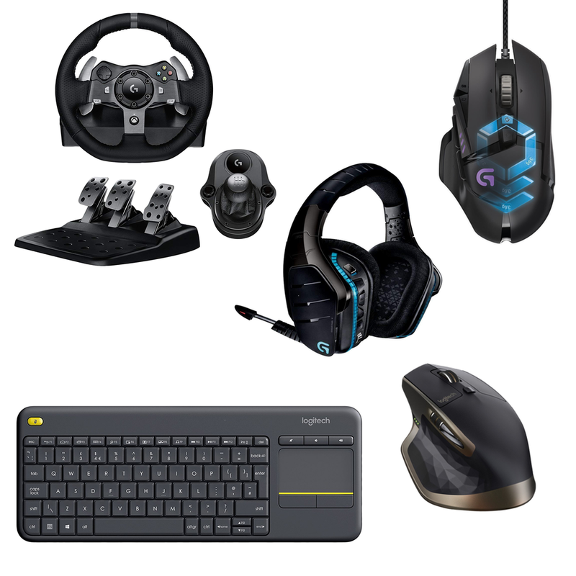
What are Haptics and Vibrations?
A Haptic interface is a UI that is dependent on contact, utilizing the developments of the user as information and the feeling of touch as yield.
Examples include force feedback joysticks and arcade steering wheels.
Notes:
B

Slide 17
Usage of haptics and vibration in React Native
The expo-haptics library allows us to customize the haptics and vibration in our application.
expo-haptics provides haptic (touch) feedback for
iOS 10+ devices using the Taptic Engine
Android devices using Vibrator system service
Notes:
B

Slide 18
Usage of haptics and vibration in React Native
Expo-haptics will not work if the following are true:
Low Power Mode is enabled
User disabled the Taptic Engine in settings
Haptic engine generation is too low (less than 2nd gen)
iOS version is less than 10 (iPhone 7 is the first phone to support this)
Notes:
B

Slide 19
Usage of haptics and vibration in React Native
To use expo-haptics, we have to perform TWO (2) things.
Installation to root folder:
Import settings:
expo install expo-haptics
import * as Haptics from 'expo-haptics';
Notes:
B

Slide 20
Demonstrations on expo-haptics example
Now that we have understood expo-haptics library and its functions.
Let’s try it out on some examples.
Notes:
B

Slide 21
What is GPS?
The Global Positioning System (GPS) is a satellite constellation supporting highly accurate positioning, navigation and timing (PNT) measurements worldwide.
As one of the first satellite positioning systems, GPS has become integral to work done worldwide, including precision agriculture, autonomous vehicles, marine or aerial surveying and defense applications.
Notes:
B

Slide 22
How does GPS work?
Like many other GNSS constellations, GPS includes THREE (3) main segments:
The space segment
Control segment
User segment
Notes:
B

Slide 23
How does GPS work?
The space segment
The GPS space segment includes over 30 satellites in orbit operated and maintained by the U.S. Space Force.
These satellites broadcast radio signals to control and monitoring stations on Earth and directly to users requiring highly precise satellite positioning.
Notes:
B

Slide 24
How does GPS work?
The control segment
The U.S. Space Force also oversees the GPS control segment.
It includes master control and backup control stations, dedicated ground antennas and several monitor stations located worldwide.
Notes:
B

Slide 25
How does GPS work?
The control segment
These stations work to ensure GPS satellites are healthy, orbiting in the correct locations and have accurate atomic clocks on board.
These stations are integral to the overall health and accuracy of the GPS constellation.
Notes:
B

Slide 26
How does GPS work?
The user segment
The user segment includes everyone relying upon GPS satellites for PNT (Positioning, Navigation and Timing) measurements.
From a mobile phone providing directions to autonomous vehicles requiring lane-level positioning accuracy.
From a farmer tracking planting and harvesting routes year-over-year to a UAV mapping a rainforest, many applications use GPS for high precision positioning and accuracy around the world.
Notes:
B

Slide 27
Consideration on the use of GPS
Since it relies on active PNT measurements, it requires a LOT of power.
It requires user consent to allow cloud applications to access their constant location.
Accuracy of data.
Notes:
B

Slide 28
Getting location details in React Native
To get access to user’s location details, we would rely on the expo-location library.
expo-location allows reading geolocation information from the device.
Your mobile application can poll for the current location or subscribe to location update events.
Notes:
B

Slide 29
Getting location details in React Native
To use expo-location, we first have to install the library to our root project.
Installation:
expo install expo-location
Notes:
B

Slide 30
Getting location details in React Native
GPS details are considered sensitive information. Thus, permissions needs to be granted before application.
useEffect(() => { (async () => { let { status } = await Location.requestForegroundPermissionsAsync(); if (status !== 'granted') { setErrorMsg('Permission to access location was denied'); return; } let location = await Location.getCurrentPositionAsync({}); setLocation(location); })(); }, []);
Notes:
B

Slide 31
Notable functions of expo-location
Location.getCurrentPositionAsync({})
Requests for one-time delivery of the user's current location.
Depending on given accuracy option it may take some time to resolve, especially when you're inside a building.
Notes:
B

Slide 32
Notable functions of expo-location
Location.getLastKnownPosition({})
Gets the last known position of the device or null if it's not available or doesn't match given requirements such as maximum age or required accuracy.
It's considered to be faster than getCurrentPositionAsync as it doesn't request for the current location, but keep in mind the returned location may not be up-to-date.
Notes:
B

Slide 33
Notable functions of expo-location
Location.geocodeAsync(address)
Geocode an address string to latitude-longitude location.
Notes:
B

Slide 34
Notable functions of expo-location
Location.reverseGeocodeAsync(location)
Reverse geocode a location to postal address.
* Note: This function can be computationally taxing.
Notes:
B

Slide 35
Notable functions of expo-location
Location.startLocationUpdatesAsync(taskName, options)
Registers for receiving location updates that can also come when the app is in the background.
Notes:
B

Slide 36
Notable functions of expo-location
Location.startGeofencingAsync(taskName, regions)
Starts geofencing for given regions. When the new event comes, the task with specified name will be called with the region that the device enter to or exit from.
If you want to add or remove regions from already running geofencing task, you can just call startGeofencingAsync again with the new array of regions.
Notes:
B

Slide 37
Demonstrations on expo-location examples
Now that we have understood expo-location library and its functions.
Let’s try it out on some examples.
Notes:
B

Slide 38
What are Accelerometers?
An accelerometer is a device that measures the vibration, or acceleration of motion of a structure.
The force caused by vibration or a change in motion (acceleration) causes the mass to "squeeze" the piezoelectric material which produces an electrical charge that is proportional to the force exerted upon it.
Since the charge is proportional to the force, and the mass is a constant, then the charge is also proportional to the acceleration.
Notes:
B

Slide 39
How are Accelerometers used in smartphones?
Accelerometer is the devices that are used to measure acceleration, the rate of change on velocity.
However, if we talk about accelerometer in smartphone, it detects changes in the orientation and accordingly rotates the mobile screen.
Basically, it helps your smartphone know up form down.
Notes:
B

Slide 40
How are Accelerometers used in smartphones?
The accelerometer is an in-built comment of a smartphone to measure its acceleration.
It tracks the different motion like shaking, tilting, swinging, and rotating and accordingly change the orientation of your app.
To calculate and detect the motion, the accelerometer uses the value of XYZ.
Notes:
B

Slide 41
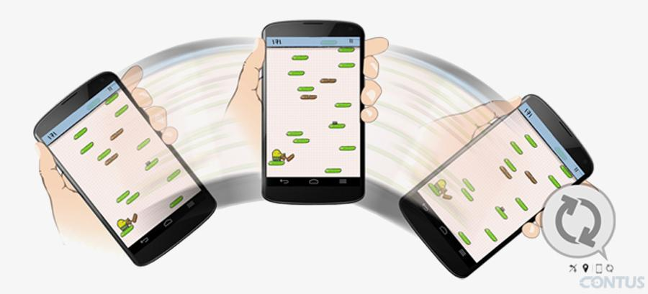
How are Accelerometers used in smartphones?
One example of Accelerometers used in smartphones.
Notes:
B

Slide 42
Using Accelerometer in React Native
Accelerometer from expo-sensors provides access to the device accelerometer sensor(s) and associated listeners to respond to changes in acceleration in 3d space, meaning any movement or vibration.
Installation:
expo install expo-sensors
Notes:
B

Slide 43
Using Accelerometer in React Native
Let’s take a look at the following code usage of expo-sensors.
const [subscription, setSubscription] = useState(null); const _subscribe = () => { setSubscription( Accelerometer.addListener(accelerometerData => { setData(accelerometerData); }) ); }; const _unsubscribe = () => { subscription && subscription.remove(); setSubscription(null); }; …
Notes:
B

Slide 44
Using Accelerometer in React Native
Let’s take a look at the following code usage of expo-sensors.
… useEffect(() => { _subscribe(); return () => _unsubscribe(); }, []);
Notes:
B

Slide 45
Demonstrations on expo-sensors examples
Now that we have understood expo-sensors library and its functions.
Let’s try it out on some examples.
Notes:
B

Slide 46
That’s all for today!
If you have any questions, please feel free to reach out to me at this email.
kydsim001@mymail.sim.edu.sg
Notes:
B

Slide 47
END OF LESSON

